Slide 1
Making Sense of Life

Slide 2
God
God is God, we are not
Notes:
As we navigate this challenging, confusing season, I want to share 5 principles I believe God is trying to show the world.
First - that HE is God and we are not. Sometimes we have to be reminded of our weakness in order to appreciate God’s power; we need to realize how little we understand to appreciate His wisdom; we need to experience our own limits to know the glory of our God who has no limits.
Ultimately this whole situation, and everything in life is about God and His glory, not about us and our comfort, desires or understanding

Slide 3
God
God is God, we are not
Totally Inaccessible
Unknowable
Three gods
Three Persons
One God
One Person
Knowable
Totally Accessible
Notes:
There is mystery here - we cannot fully understand God or everything that happens in life - which is why we must walk by FAITH, not by SIGHT. We want to understand everything, but that’s the point - we CAN’T understand everything - but there is a God who does and it is for us to trust in Him.

Slide 4
God
God is God, we are not
Totally Inaccessible
Harsh or cruel
The Cause of evil
Unknowable
Just
Sovereign
Three gods
Three Persons
One God
One Person
Empowering
Loving
Overriding
Free will
Knowable
Ignoring Evil
Totally Accessible
Notes:
When we consider the infinite perfections of God - His glory, sovereignty, justice, holiness, love and grace - when we step into the light of His supremacy, it should quickly remind us of our own weakness, sinfulness, lack of love and lack of understanding.
Consider Job -

Slide 5
And the Lord said to Satan, “Have you considered my servant Job, that there is none like him on the earth, a blameless and upright man, who fears God and turns away from evil?” 9 Then Satan answered the Lord and said, “Does Job fear God for no reason? 10 Have you not put a hedge around him and his house and all that he has, on every side? You have blessed the work of his hands, and his possessions have increased in the land. 11 But stretch out your hand and touch all that he has, and he will curse you to your face.” 12 And the Lord said to Satan, “Behold, all that he has is in your hand. Only against him do not stretch out your hand.” So Satan went out from the presence of the Lord. Job 1:8-12

Slide 6
And the Lord said to Satan, “Have you considered my servant Job, that there is none like him on the earth, a blameless and upright man, who fears God and turns away from evil?” 9 Then Satan answered the Lord and said, “Does Job fear God for no reason? 10 Have you not put a hedge around him and his house and all that he has, on every side? You have blessed the work of his hands, and his possessions have increased in the land. 11 But stretch out your hand and touch all that he has, and he will curse you to your face.” 12 And the Lord said to Satan, “Behold, all that he has is in your hand. Only against him do not stretch out your hand.” So Satan went out from the presence of the Lord. Job 1:8-12
Notes:
God is the One who initiated this encounter.
God was protecting and blessing Job - as the source of all he had.
God allowed Satan to attack Job’s family and possessions, but put limits on what the devil could do.
It’s clear this whole situation was about GOD not about JOB - God was reminding Job that HE was God and Job was not God.
Job was a righteous man who feared God and turned away from evil. But this would be Job’s great test. Would he continue in that faith and obedience, or would his commitment to the Lord waver?

Slide 7
20 Then Job arose and tore his robe and shaved his head and fell on the ground and worshiped.
21 And he said, “Naked I came from my mother's womb, and naked shall I return.
The Lord gave, and the Lord has taken away; blessed be the name of the Lord.”
22 In all this Job did not sin or charge God with wrong.
Job 1:20-22
Notes:
When Job lost everything in terms of his possessions and children, look at his response!

Slide 8
20 Then Job arose and tore his robe and shaved his head and fell on the ground [GRIEF] and worshiped.
21 And he said, “Naked I came from my mother's womb, and naked shall I return. [HUMILITY]
The Lord gave, and the Lord has taken away; blessed be the name of the Lord.” [FAITH]
22 In all this Job did not sin or charge God with wrong.
Job 1:20-22
God is God, we are not
Notes:
When Job lost everything in terms of his possessions and children, look at his response!
Grief, acknowledging pain and loss
Humility - recognizing he came with nothing and would leave with nothing
Faith - the Lord has the right to give and take away - he did not charge God with wrong.
This is what the whole book of Job is about - when we suffer, will we charge God with doing wrong or will we trust Him, continuing to worship and serve Him?

Slide 9
Then the Lord answered Job out of the whirlwind and said:
2 “Who is this that darkens counsel by words without knowledge?
3 Dress for action like a man;
I will question you, and you make it known to me.
4 “Where were you when I laid the foundation of the earth? Tell me, if you have understanding…”
Job 38:1-4
God is God, we are not
Notes:
At first, Job dealt well with his suffering, expressing faith in the Lord. But over time, Job came to question God, demanding his day in court. He wanted answers from God.

Slide 10
6 Then the Lord answered Job out of the whirlwind and said:
7 “Dress for action like a man;
I will question you, and you make it known to me.
8 Will you even put me in the wrong?
Will you condemn me to justify yourself?
9 Have you an arm like God,
and can you thunder with a voice like his?
10 Adorn yourself with majesty and dignity;
clothe yourself with glory and splendor…”
Job 40:6-10
God is God, we are not
Notes:
Job was silenced for questioning God.
This is what we are tempted to do when we are in pain - to question the wisdom, power and goodness of God. We may go so far as to CONDEMN GOD to justify ourselves. The story of Job reminds us how unqualified we are to attempt this.
We simply do not have the knowledge or power or glory to question God. We can’t see the whole picture. We can’t understand the scope of history. We can only see a tiny speck.
Let’s say you’re building a house for your family and a TERMITE comes to you and says, “Hey, that was our spot. We had this old log we have been living in and feeding on. It’s really not right for you to build something and displace us. We found this place - we got here first. Shove off and set up somewhere else.”
Would you listen to that Termite? That is our vantage point compared to God’s… HE is God. We are not. That’s the first principle to remember here.

Slide 11
10 Not only that, but Rebekah’s children were conceived at the same time by our father Isaac. 11 Yet, before the twins were born or had done anything good or bad—in order that God’s purpose in election might stand: 12 not by works but by him who calls—she was told, “The older will serve the younger.”
13 Just as it is written: “Jacob I loved, but Esau I hated.”
Romans 9:10-13
Notes:
Second - God is reminding us of what we DESERVE.
Romans 9 gives us two examples: Jacob and Pharaoh.
Why did God choose Jacob to be the Father of His people? Was it because Jacob was so good and righteous and friendly?
Do you remember the stories about Jacob? He was pretty much the worst. He was the most conniving, deceptive trickster, which is what his name means! God did not choose Jacob because he was great and reject Esau because he was terrible. God did the choosing BEFORE they were even born - before either of them had done anything!
What does this teach us? That IT’S NOT ABOUT US. It’s all about GOD. His purpose; His plan; His glory.

Slide 12
16 It does not, therefore, depend on human desire or effort, but on God’s mercy.
17 For Scripture says to Pharaoh: “I raised you up for this very purpose, that I might display my power in you and that my name might be proclaimed in all the earth.”
Romans 9:16-17
2. We deserve hell; anything else is mercy
Notes:
Did God punish Pharaoh and Egypt because they were so terrible - yes, partly because of that. But mostly it was to demonstrate His own power and show the world the glory of the Name of the Lord, the God of Israel.
Here is the second lesson God is teaching us - we don’t deserve any better than Pharaoh and the Egyptians or the Canaanites. We are no better than they are. We deserve death and hell - every one of us deserves only judgment from God. Anything He gives us other than wiping us out immediately is mercy.

Slide 13
20 But who are you, a human being, to talk back to God? “Shall what is formed say to the one who formed it, ‘Why did you make me like this?’”
21 Does not the potter have the right to make out of the same lump of clay some pottery for special purposes and some for common use?
Romans 9:20-21
2. We deserve hell; anything else is mercy
Notes:
It comes down to a question of RIGHTS and OWNERSHIP. Since God created and owns everything He has the right to do with it exactly as He wants.
If you purchase wood and build a birdhouse, painting it and decorating it with little plastic jewels - you have the rights of ownership. You can keep it in your room and hang your earrings on it, or your favorite ball cap. Or you can place it outside and let a bird come and live there. It’s yours. You made it. If your brother or sister comes by and breaks it, or if a squirrel chews it up outside - you would be right to be upset that it is not being used as you - the maker - intended.
That is how God feels about His world. He made it. It’s His. He can do with it what He pleases. We are no more in a position to question Him than the squirrel is to question you about your birdhouse. He is the Potter, we are the clay. Clay is not known for its great wisdom and ability.

Slide 14
God
God is God, we are not
2. We deserve hell; anything else is mercy
Notes:
So we see - everything that happens, whether good or bad - is about God, not us. It is His work, His plan, His Name. He is God - we are not.
Job teaches us it is about HUMILITY, to acknowledge God, not question Him. It is about FAITH - to trust in God, not doubt His goodness, power and love.
Second - God is reminding us what we deserve - we are not entitled to a happy, comfortable American Dream kind of life. All of us deserve death and hell. Everything God has given us is a sign of His infinite mercy.
So all of life is a TEST: will we live for God or for ourselves? Will we trust in Him or something else? Will we make our lives about GOD or will we turn away from Him?

Slide 15
24 “Everyone then who hears these words of mine and does them will be like a wise man who built his house on the rock. 25 And the rain fell, and the floods came, and the winds blew and beat on that house, but it did not fall, because it had been founded on the rock.
Matthew 6:24-25
3. Only Jesus can save us - now and forever
Notes:
Here is our third lesson: only Jesus can save us - now and forever.
What is it that gives us a FIRM FOUNDATION through any storm?

Slide 16
24 “Everyone then who hears these words [FAITH]of mine and does them [OBEDIENCE] will be like a wise man who built his house on the rock. 25 And the rain fell, and the floods came, and the winds blew and beat on that house, but it did not fall, because it had been founded on the rock.
Matthew 6:24-25
3. Only Jesus can save us - now and forever
Notes:
What is it that gives us a FIRM FOUNDATION through any storm?
Faith that hears God’s Word and believes it, resulting in:
Obedience to the commands of God.
And what is the STORM that this protects us from?
Hardships of life, for sure
But mainly the ultimate storm - the wrath of God

Slide 17
37 For as were the days of Noah, so will be the coming of the Son of Man. 38 For as in those days before the flood they were eating and drinking, marrying and giving in marriage, until the day when Noah entered the ark, 39 and they were unaware until the flood came and swept them all away, so will be the coming of the Son of Man.
Matthew 24:37-39
3. Only Jesus can save us - now and forever
Notes:
The story of Noah and the Ark is a picture for us of the flood that is coming - the flood of God’s righteous judgment on the world. That is the main thing everyone needs protection from. And what protects us from that flood is FAITH in the Lord Jesus, demonstrated by obedience to His commands. In the case of Noah, it was building the Ark, gathering the animals, and getting on board.
Now it is the gospel of the Lord Jesus Christ. Will people come to Jesus to be saved or will they ignore him as they did the Ark in Noah’s day?
This is why it’s important to UNDERSTAND what God is doing in history right now - so we have the right EXPECTATIONS.

Slide 18
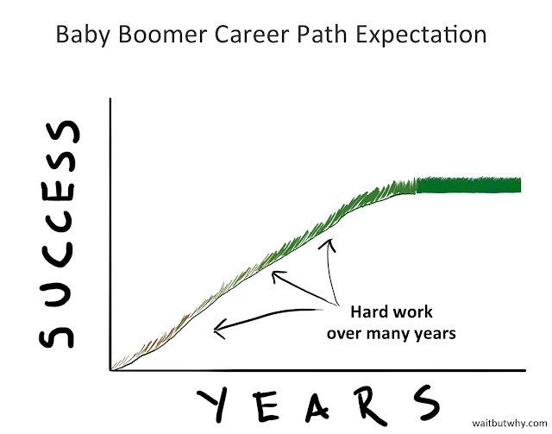
Notes:
Here is what your grandparents expected from life -
https://waitbutwhy.com/2013/09/why-generation-y-yuppies-are-unhappy.html

Slide 19
Notes:
This is why your grandparents were, for the most part, happy with life.

Slide 20
Notes:
This is what most “Gypsy” Millennials expect from life

Slide 21
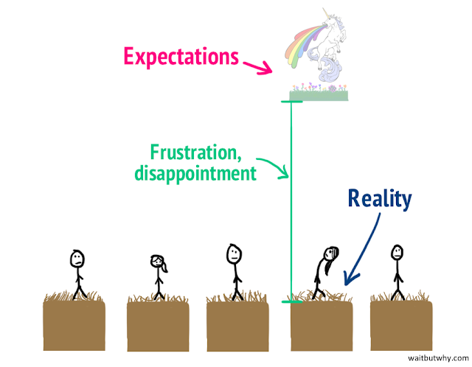
Notes:
Of course, life is way harder than that, and even if you really ARE amazing, you’re not going to get the dream job, dream home and dream family in just a year or two - these things take lots of hard work and a good amount of time!

Slide 22
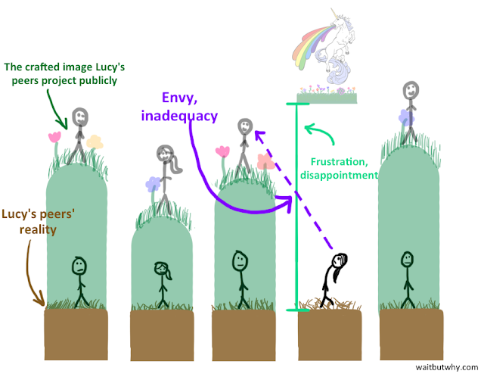
Notes:
And then you measure yourself not against the REALITY of your peers but against what they SHOW the world - what they PROJECT on social media and elsewhere.

Slide 23
Notes:
The point of this article was to adjust expectations. Change from unrealistic and unattainable expectations to more realistic ones.
https://waitbutwhy.com/2013/09/why-generation-y-yuppies-are-unhappy.html
That approach will help you - but it is still not the Biblical way, the Christian way. Consider what we should EXPECT from life...

Slide 24
23 Then he said to them all: “Whoever wants to be my disciple must deny themselves and take up their cross daily and follow me. 24 For whoever wants to save their life will lose it, but whoever loses their life for me will save it. 25 What good is it for someone to gain the whole world, and yet lose or forfeit their very self?”
Luke 9:23-25
4. Christians should expect suffering now
Notes:
What does it mean to follow Jesus? It does not mean to adjust your expectations from becoming rich and famous quickly to just having a good life eventually. To follow Jesus is to RADICALLY REALIGN EVERYTHING AROUND HIM - to abandon your old life and give everything to Him. To take up your CROSS so your old life will die.
Here is our fourth principle - Christians should expect a life of service and sacrifice - like JESUS - not a life of comfort and ease in this world.

Slide 25
4. Christians should expect suffering now
Humility
Dependence
S U C C E S S
Service
Sacrifice
Y E A R S
Notes:
What Jesus calls us to is a path of DOWNWARD MOBILITY - the path of humility, dependence, service and sacrifice. It’s the way of the cross; the way of self sacrifice, not self-promotion, not self-actualization.

Slide 26
4. Christians should expect suffering now
Humility
Dependence
S U C C E S S
About ME
About GOD
Service
Sacrifice
Y E A R S
Notes:
What Jesus calls us to is a path of DOWNWARD MOBILITY - the path of humility, dependence, service and sacrifice. It’s the way of the cross. It is about letting go of my life to giving all I am to the Lord. It’s about making my entire life about HIM and not about ME. It’s not about MY dreams, MY plans, MY desires, MY happiness - it’s about God’s desires, His plan, His will, His goals. And, of course, when we reorient our lives in devotion to God, we find the truest, deepest happiness IN GOD - the joy our souls have been hungering for all along!

Slide 27
“Take up their cross daily” Luke 9:23
4. Christians should expect suffering now
Humility
Dependence
“He must become greater; I must become less.” John 3:30
S U C C E S S
Service
“In this world you will have trouble.”
John 16:33
Sacrifice
Y E A R S
Notes:
This is the path of John the Baptist who said, “He must become greater; I must become less.”
The promise of the gospel is not a happy and comfortable life IN THIS WORLD. Jesus made it clear that “In this world you will have trouble.” Christians should expect to make sacrifices for others, to face persecution and opposition - as Jesus did. The promise of the gospel is happiness and blessing IN ETERNITY!

Slide 28
5. Our promise is everlasting joy
Humility
Dependence
“Store up… treasure in heaven.” Matt. 6:20
S U C C E S S
Service
Sacrifice
“Whoever loses his life for me will save it.” Luke 9:24
“Everyone who humbles himself will be exalted.” Lk. 14:11
Y E A R S
E T E R N I T Y
Notes:
The only way to be saved is to lose your life for Jesus - surrender it all to Him. The path to REAL BLESSING begins with humility and moves through total commitment to the Lord Jesus. It is only when we humble ourselves that we will be exalted. And that promise is not of earthly glory, but of reward in HEAVEN. This is the fifth principle God is teaching us - that our promise is everlasting joy. This is our hope, our blessed assurance - not of an easy, comfortable, “happy” life now - but of the future grace of God, the blessing, reward, joy and GLORY that we will experience when we see Him face to face! Then we will say, with Paul, “this light and momentary affliction is achieving for us an ETERNAL WEIGHT OF GLORY that far outweighs them all.” 2 Cor. 4:17

Slide 29
“Not one stone will be left on another; every one will be thrown down.” Matt. 24:2
Deception
Devastation
Persecution
“Then there will be great distress, unequaled…” Matt. 24:21
S U C C E S S
Desertion
“All these are the beginning of birth pains.” Matt. 24:8
Execution
“You will be persecuted… and put to death.” Matt. 24:9
Y E A R S
Notes:
And this pattern is not just how God works in our lives individually, it is what is happening in history right now too.
Matthew 24 outlines what to expect in these LAST DAYS - an increase in 1) deception - false teaching, false Messiahs; 2) devastation - wars, conflict, terrorism, famines, earthquakes, diseases; 3) persecution - as Christians are singled out and attacked; 4) desertion - as those who are weak turn away from Jesus and 5) execution - many believers will be put to death, martyrs for their faith.

Slide 30
“The one who stands firm to the end will be saved.” Matt. 24:13
Deception
Devastation
“Do not be afraid of what you are about to suffer. I tell you, the devil will put some of you in prison to test you, and you will suffer persecution for ten days. Be faithful, even to the point of death, and I will give you life as your victor’s crown.”
Rev. 2:10
S U C C E S S
Persecution
Desertion
Execution
“Those who had been beheaded… reigned with Christ.” Rev. 20:4
Y E A R S
E T E R N I T Y
Notes:
Our promise is EVERLASTING Joy - not in this world, but in the next one. In this life we should expect suffering, sacrifice and eventually death (whether, natural, accidental or through martyrdom).
We don’t experience it here in the US., but more than 100 million Christians are persecuted right now for their faith - more than ever in history. The day WILL come when that persecution begins for us. The birth pains will turn into active labor and all of these signs will intensify.
Revelation 6 - “When he opened the fifth seal, I saw under the altar the souls of those who had been slain because of the word of God and the testimony they had maintained. 10 They called out in a loud voice, “How long, Sovereign Lord, holy and true, until you judge the inhabitants of the earth and avenge our blood?” 11 Then each of them was given a white robe, and they were told to wait a little longer, until the full number of their fellow servants, their brothers and sisters, were killed just as they had been.”

Slide 31
“This light and momentary affliction is achieving… eternal glory.” 2 Cor. 4:17
Deception
Devastation
“I consider that our present sufferings are not worth comparing with the glory that will be revealed in us.”
Romans 8:18
S U C C E S S
Persecution
Desertion
Execution
“We groan… as we wait for… the redemption of our bodies.” Rom. 8:24
Y E A R S
E T E R N I T Y
Notes:
5. Our promise is everlasting joy - the promise is not just of heaven as we often think of it - a place of light and peace when we die. The promise for the believer in Jesus is far greater than this. Yes, there is peace when you die, heaven is a glorious place. But the promise goes on into eternity in the new heaven and new earth, after Jesus comes back and we are reunited with our physical bodies in the resurrection. Then our experience will not just be described by JOY but by GLORY. We will “become like him when we see Him as He is.” 1 John 3:2
That is when we will be GLORIFIED - when the last remnants of our sins are burned away and the image of Christ is fully realized in us.
We experience a foretaste of eternity now in a relationship with God (John 17:3) but it is just a foretaste, just an appetizer. Our true promise is for joy in eternity.

Slide 32
What God is Teaching us Today:
God is God, we are not
We deserve hell; anything else is mercy
Only Jesus can save us - now and forever
Christians should expect suffering
Our promise is everlasting joy

